Slide 1
Learning How to Study the Bible
The Use of Bible Helps – Book List

Slide 2
The Use of Bible Helps
Caution!
The works of men are subject to error
Especially – Commentaries & Doctrinal books
Always look for biases and agendas!
Notes:
Note: We are going old school today (showing how to utilize some of the actual books)!
If you are at all comfortable with either using apps on your phone, programs on your computer, or surfing on the internet, there are free and helpful copies of most of these same reference works on the internet. We will show them next week.

Slide 3
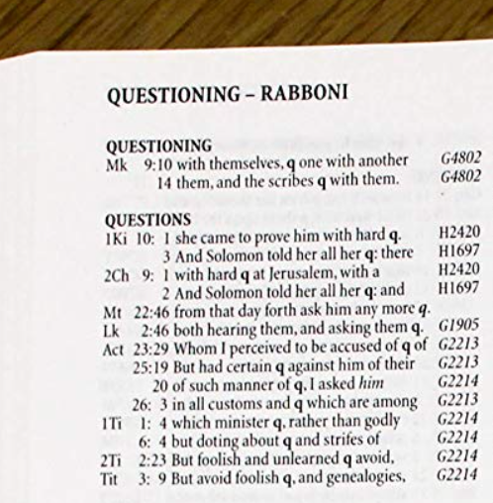
Strong’s Concordance
Look up word (KJV)
Each time the word is used in the Bible, it is listed, along with a portion of the verse (for context)
Notice the numbers
H – Hebrew (OT)
G – Greek (NT)
Notes:
The Word Questions is found 14 times in the KJV of the Bible
Two different Hebrew words (H2420; H1697)
Two different Greek words (G1905; G2213/2214)
H2420 – Queen of Sheba asking “hard” questions of Solomon
Khee-daw – Riddle, difficult question, enigma
H1697 – Solomon told the Queen of Sheba all her “questions”
Daw-baw – speech, utterance, words
(In this case, basically Solomon had all the answers)
G1905 – Jesus asking questions at the age of 12
ep-er-o-tah’-o: ask for, inquire, seek, desire, demand
Interestingly, - In Matthew 22:46 – There is no Greek word there. The translators supplied it, as the Jews dared not ask anymore (questions).
G2213
dzay'-tay-mah: a debate, a question
G2214
dzay'-tay-sis: a seeking, an inquiry

Slide 4
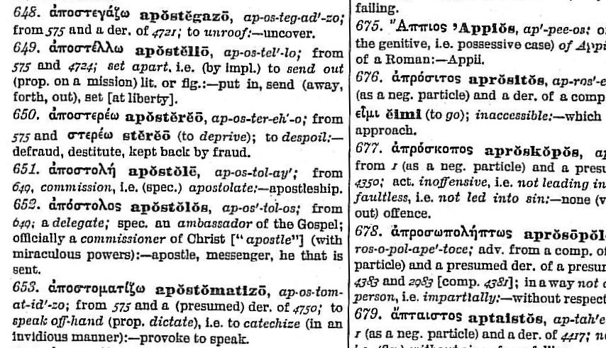
Strong’s Concordance – Look Up Number at Dictionary in Back
Notes:
The definition here supplied (In the Greek dictionary at the back of Strong’s) is for the word that is translated “apostle” in the KJV and NKJV.
Interestingly, a transliteration (common) rather than a translation
Apostolos
A delegate, an ambassador (of the gospel)
A commissioner of Christ
He that is sent.

Slide 5
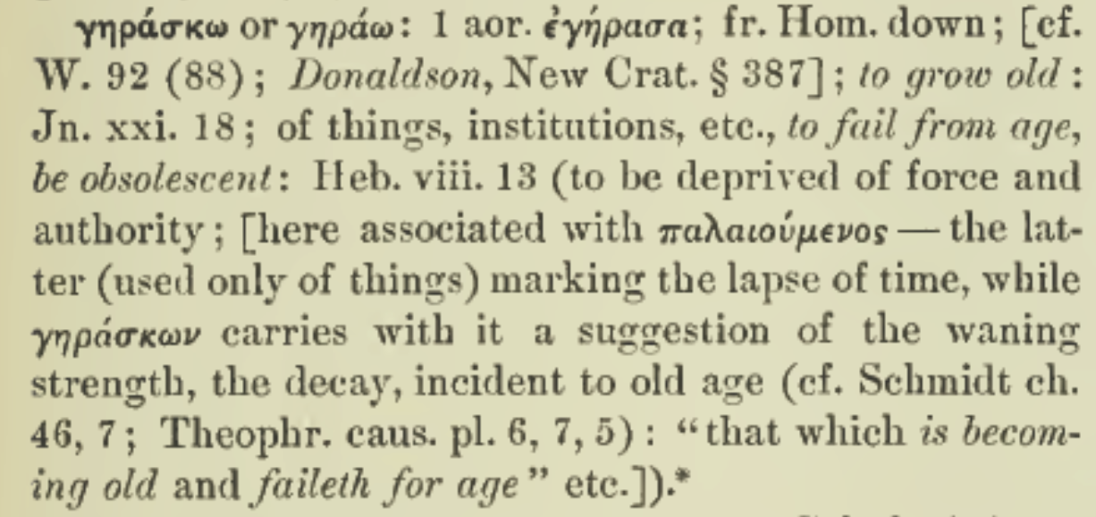
Thayer’s Lexicon – (gēraskō – KJV – “waxeth old”) – Heb. 8:13
α, β, γ, δ, ε, ζ, η, θ, ι, κ, λ, μ, ν, ξ, ο, π, ρ, σ/ς, τ, υ, φ, χ, ψ, ω
Notes:
Older editions of Thayer’s are more challenging to use (as they are not coded to the Strong’s numbers.
So, you must first look up the Greek word
Then, match the word (in Greek alphabetical order) to the entry in Thayers.
(Hebrews 8:13, KJV), “In that he saith, A new covenant, he hath made the first old. Now that which decayeth and waxeth old is ready to vanish away.
Greek - ghay-ras’-ko
So, Hebrews 8:13 teaches that the old covenant, as an institution, has become obsolete. It no longer has force and authority over a Christian.

Slide 6
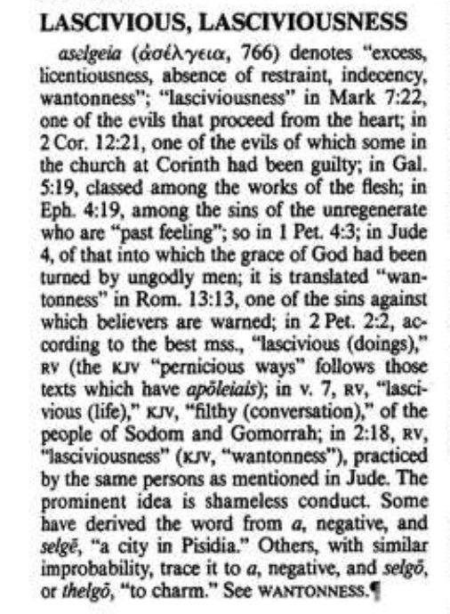
Vine’s Dictionary
Look up word (KJV)
Here, lascivious – ness
Note: Definitions, as well as usage in various passages. (Vine supplies context)
“excess, licentiousness, absence of restraint, indecency, wantonness”

Slide 7
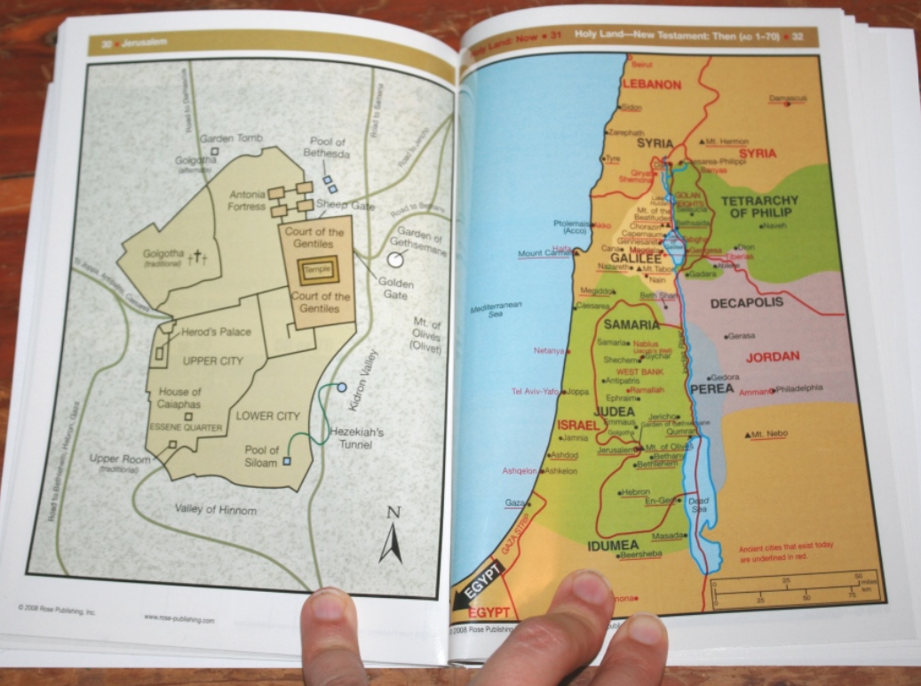
Bible Atlas Generic
Maps
Diagrams
Culture
Many available

Slide 8
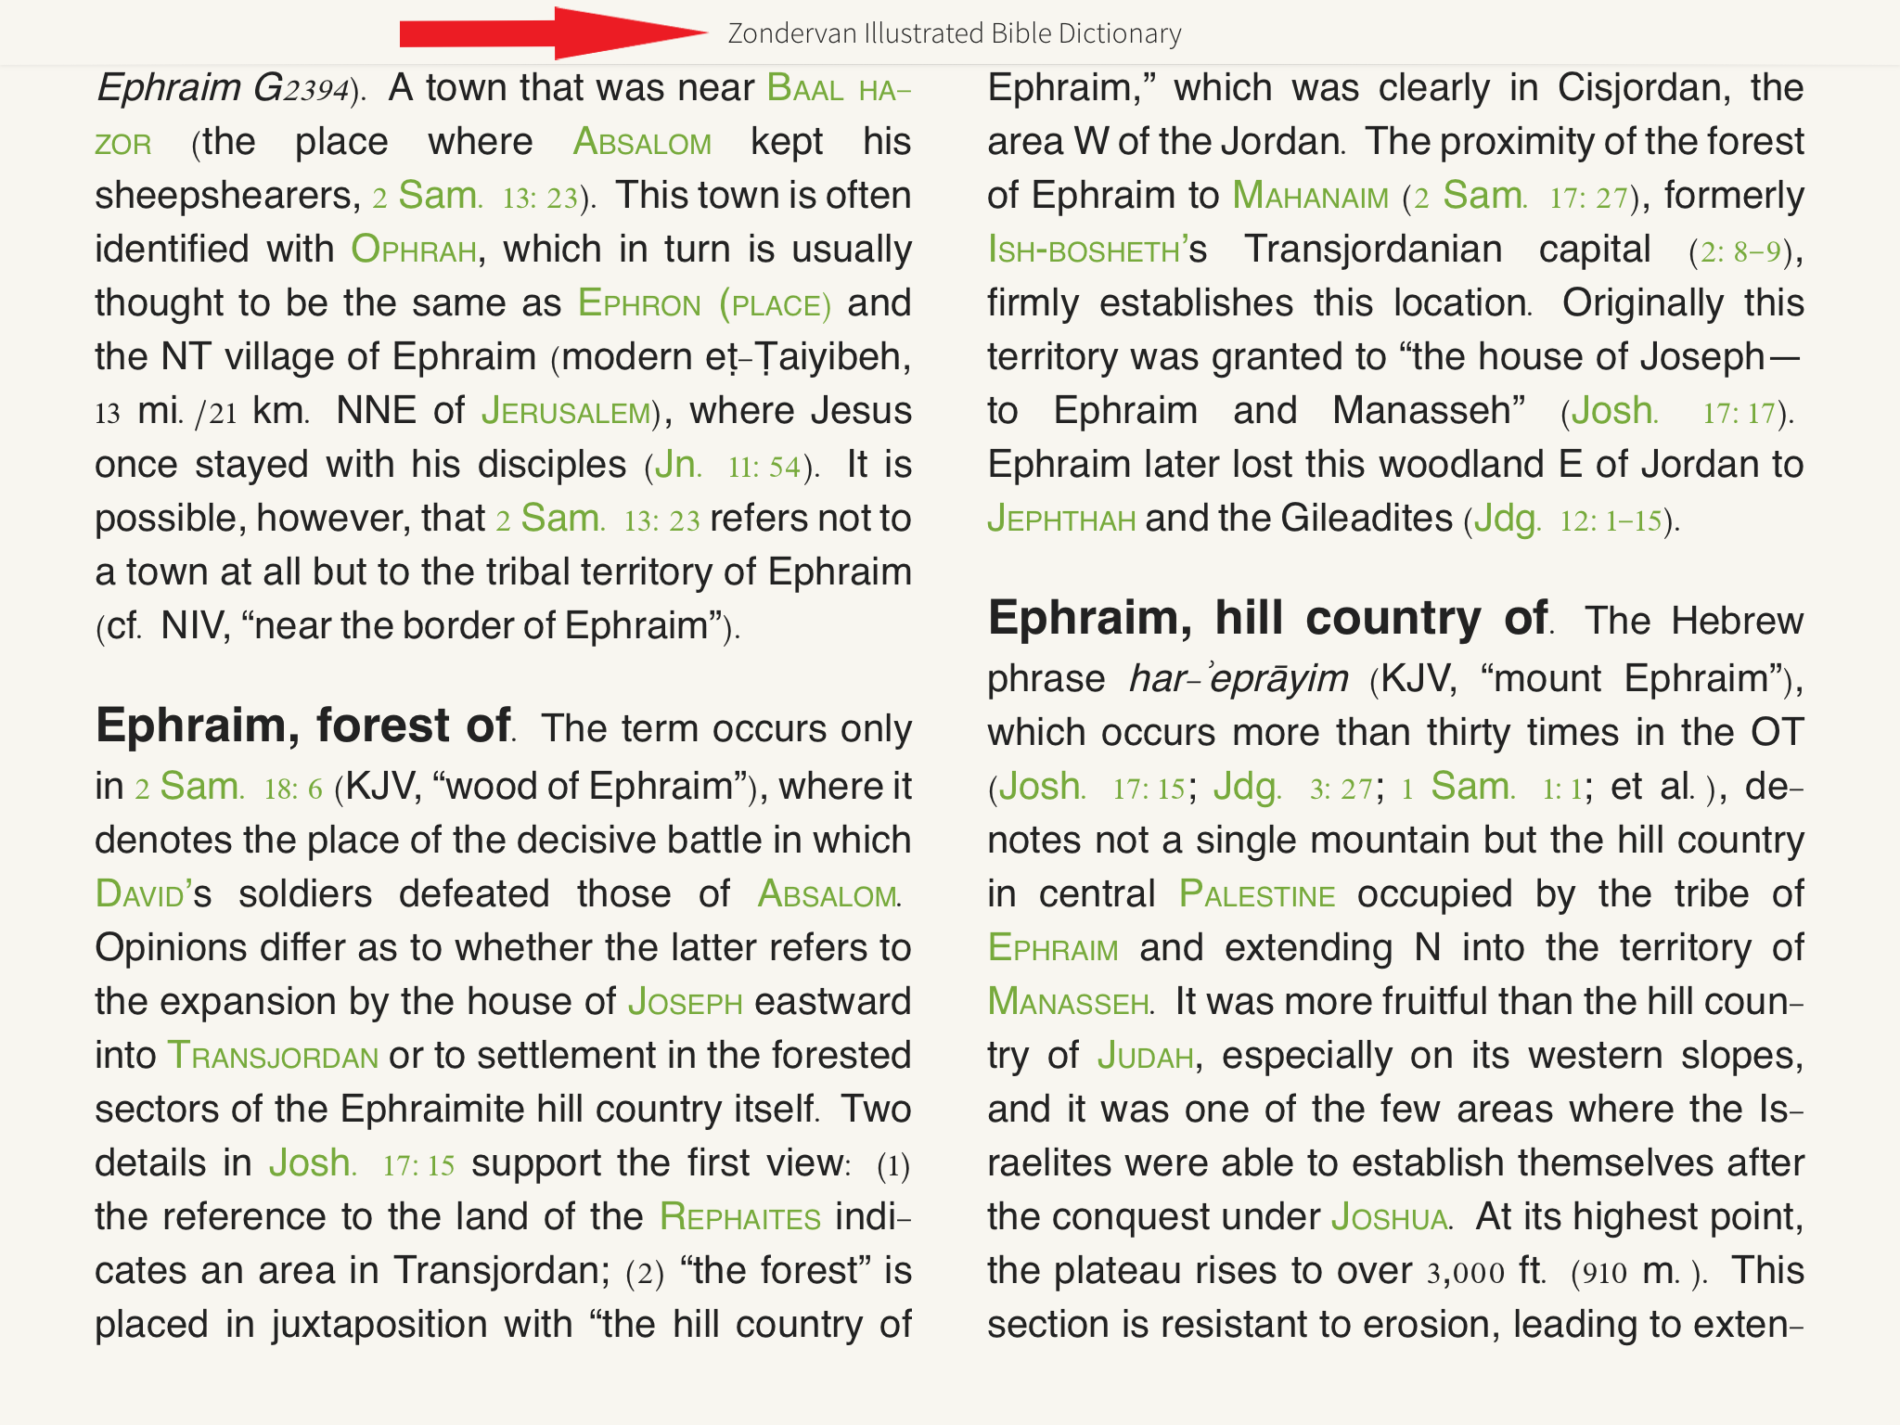
Bible Dictionary Zondervan
People
Places
Objects
Events
Short definitions
Notes:
Note: There are a lot of Bible Dictionaries out there. I typically use an Unger’s (though I seldom use this resource, it IS good for Bible classes). Just because I have Unger’s in my library.

Slide 9
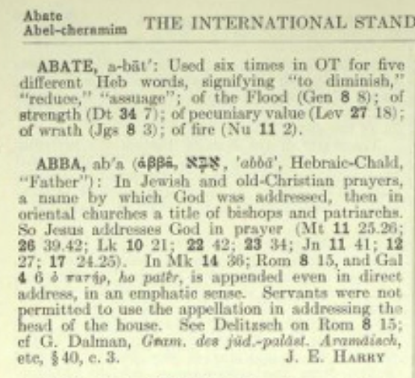
ISBE
Out of Print, but good resource.
Can be purchased online (maybe found in used book stores).
Free online.
Usually longer articles like in a regular encyclopedia
Notes:
Note: Here a reference to the term ABBA
Literally Father – In Jewish and Christian prayers, used as an address of God
Jesus addressed God using the term in numerous instances
Interestingly, it was not a term allowed to servants as they addressed their masters. (a term of endearment limited to the children).

Slide 10
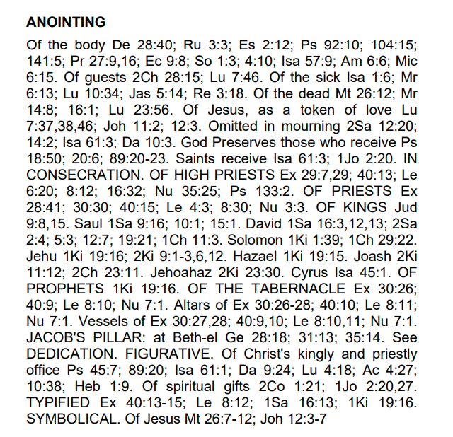
Topical Bible Nave’s
List of verses where the topic is referenced.
Explanation of context where used.
Notes:
Note: There are many topical Bibles, some contain more information regarding the topic. Others just passages where the topic is addressed.
I use Nave’s simply because I was gifted a copy.

Slide 11
The Use of Bible Helps
Commentaries
Simply, a personal view of a passage
Most commentaries are sectarian (Pulpit C.)
My preference, especially for those who are beginning their Bible study, is to limit yourself to the works of other Christians
Notes:
Gospel Advocate (14 volumes)
I found them limited in effectiveness. If I want help with a passage, I seldome find it, as the commentaries are not in-depth treatments of the text.
Truth Commentaries (15 volumes)
My favorite. (Some volumes still available in print. Their emphasis is to sell electronic for Kindles and via PDF). Note: Not quite finished.
Bible Study Textbook Series (59 volumes)
Now only available Via PDF files online (can be downloaded to phones, tablets and computers) Computer works best
Why no longer published? Because the Christian Church (where they come from) no longer believe much of the scholarship in them (More liberal now).
Truth for Today Commentaries
No personal knowledge
I have heard good things. On sale at CEI
The People’s New Testament
Good to carry with Bible for quick thoughts (in one volume, very concise explanations)
Numerous Single Commentaries by Christians
Homer Hailey – Minor Prophets, Isaiah, Daniel, John, Revelation
R.L. Whiteside, Moses Lard – Romans
McGarvey – Acts
Conybeare & House – The Epistles of Paul
Harmonies of the Gospels

Slide 12
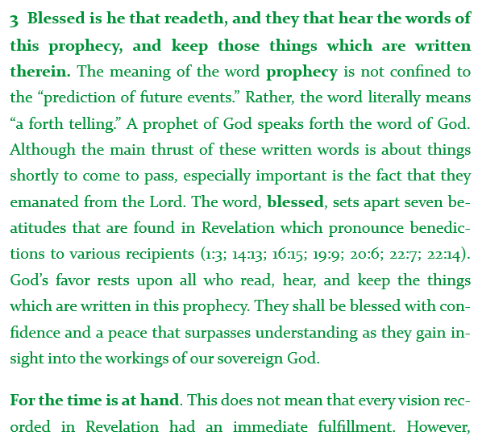
Truth - Revelation Robert Harkrider
(Revelation 1:3)
Typical set up of a commentary.
Take a sentence or clause, and explain it.
Notes:
Purpose of a commentary, written or spoken, explained in Nehemiah:
(Nehemiah 8:7-8), “Also Jeshua, Bani, Sherebiah, Jamin, Akkub, Shabbethai, Hodijah, Maaseiah, Kelita, Azariah, Jozabad, Hanan, Pelaiah, and the Levites, helped the people to understand the Law; and the people stood in their place. ⁸ So they read distinctly from the book, in the Law of God; and they gave the sense, and helped them to understand the reading.”
“The meaning of the word prophecy is not confined to the “prediction of future events.” Rather, the word literally means “a forth telling.” A prophet of God speaks forth the word of God. Although the main thrust of these written words is about things shortly to come to pass, especially important is the fact that they emanated from the Lord.”

Slide 13
The Use of Bible Helps
Debate Books
Two types
Christians defending the truth against religious or secular error
Christians discussing issues (false doctrines) that have divided brethren, to get to the truth.
Notes:
Debate books are of two types:
Christians VS Religious or Secular error
Alexander Campbell debated a famous socialist reformer Robert Owen, who declared that all religions are false. The debate was held in 1829. (Famous).
Debates have been held on evolution VS creation.
Also, various demoninational doctrines, like: Premillennialism, Calvinism, Denominationalism, Catholicism, Faith Only, etc.
Christians debating doctrinal differences in a defense of Truth
Roy Cogdill debated Guy Woods on the topic of institutionalism (that troubled brethren, and led to a split in the 1950’s) It was held in Birmingham, Alabama is 1957
Brother Cogdill’s initial speech is considered one of the best ever lessons on authority as it pertains to establishing doctrinal truth
Issues such as: Instrumental music, Institutionalism, MDR, Fellowship, etc. have all been debated and transcribed into books. (audio and video is often available as well).

Slide 14
The Use of Bible Helps
Topical/Doctrinal Works
Many preeminent Bible doctrines have been written about.
Books written to either defend or refute a specific doctrinal position.
Notes:
Examples of Topical/Doctrinal books are listed on the page handed out.
Example: Homer Hailey’s “From Creation to the Day of Eternity” (CEI for $15) is a wonderful work.
Shows the scarlet thread of Redemption that ties the entire Bible together as it winds from Genesis to Revelation.
If you want books on parenting, the husband/wife relationship, Christian living; or books on morals and ethics; or books refuting error; or books explaining truths; all of these have been written about and published by brethren.
(Many resources online that will be discussed next week.
Final: Any questions? Or, talk with me later and I will help you to get resources you desire!

